Slide 1
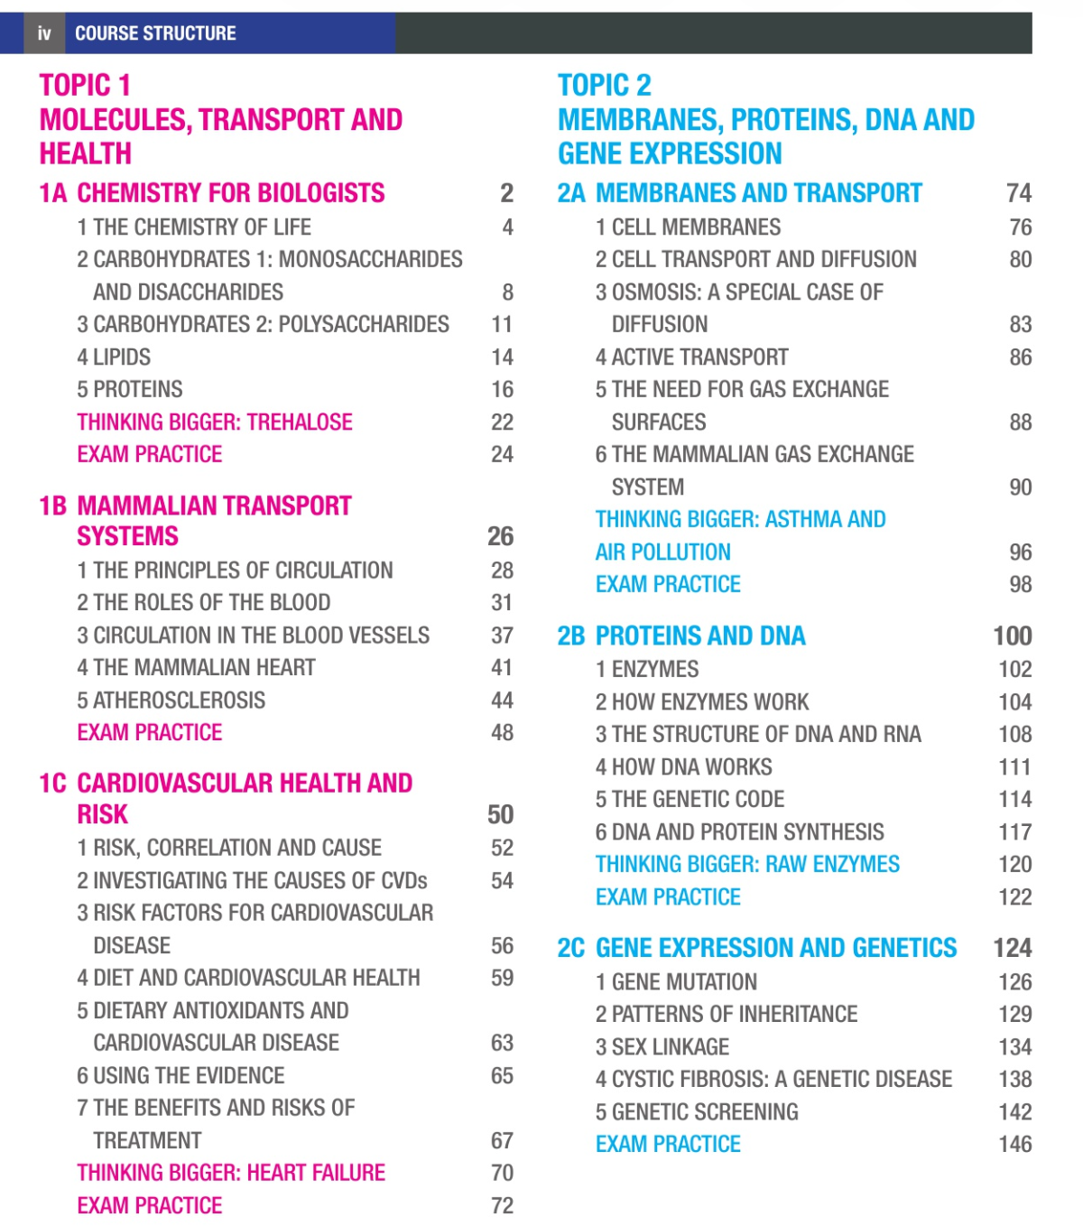
UNIT 1 TOPICS

Slide 2
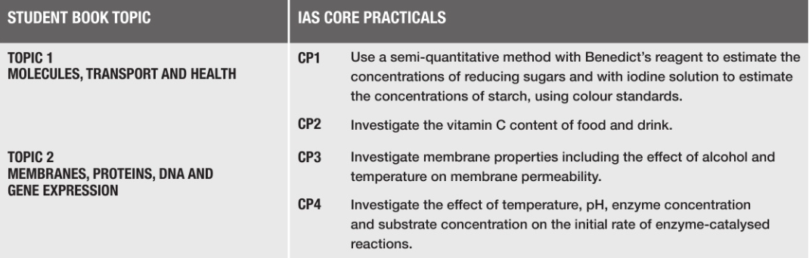
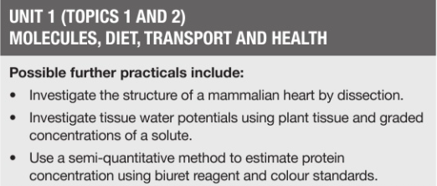
UNIT 1 PRACTICALS -7
Core Practicals →
Recommended Practicals →

Slide 3
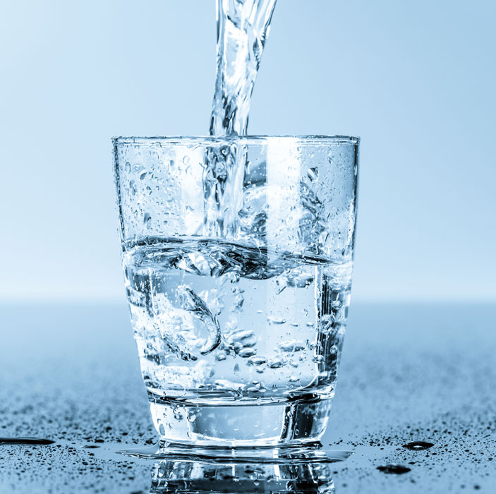

BIOLOGY
UNIT 1-TOPIC 1A 1
THE CHEMISTRY OF LIFE
WATER

Slide 4
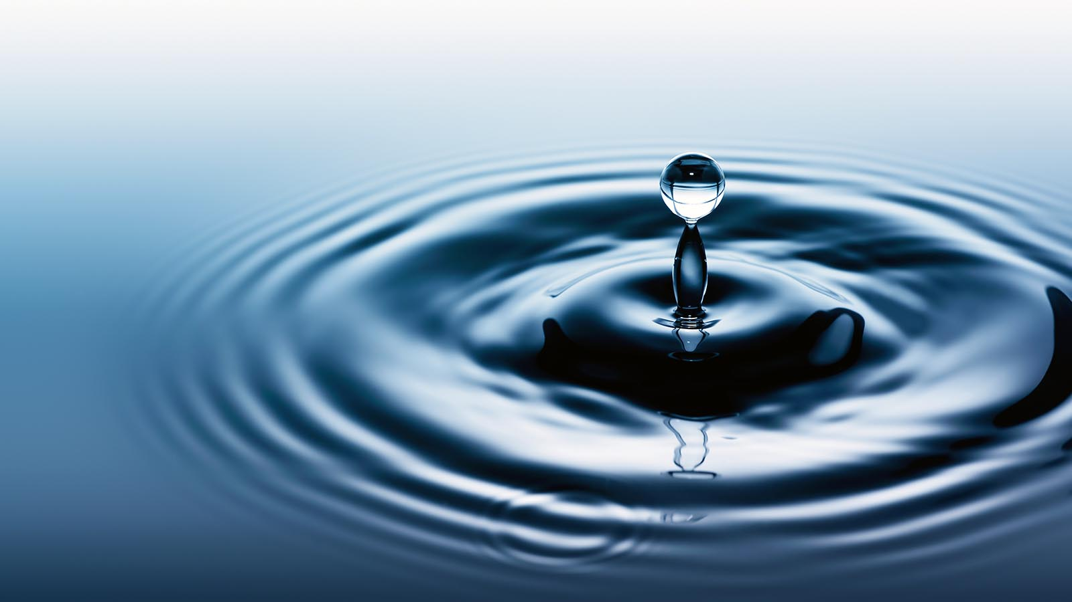
Prior knowledge
Life process depend on molecules whose structure is related to their function.
All living things are made up of cells.
Many processes in living cells, including diffusion and osmosis, depend on water.
Reactions in cells take place in solution in water.

Slide 5
Learning Objective
Understand the importance of water as a solvent in transport, including its dipole nature.

Slide 6
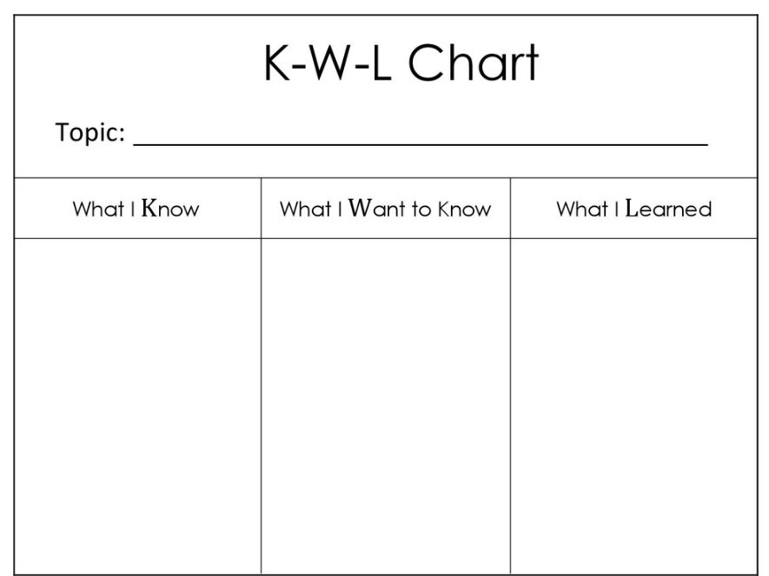

Slide 7
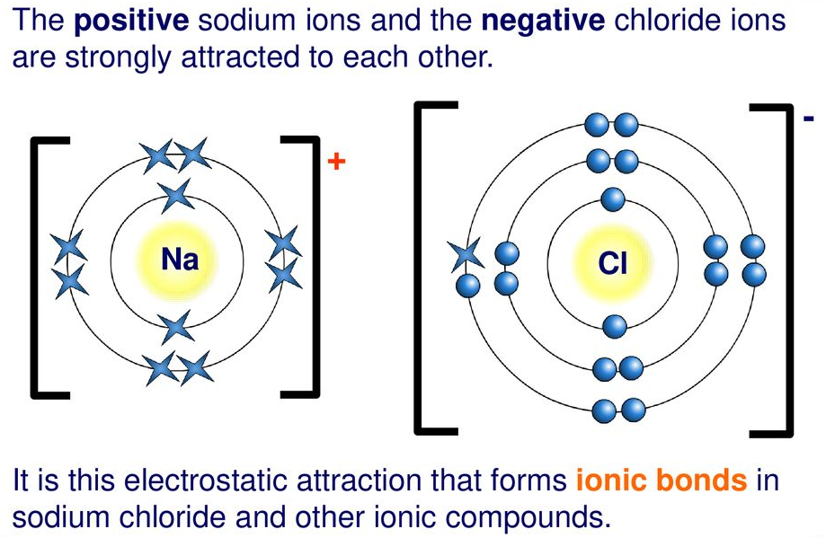
Ionic bonding
Ionic bonding | Example
The atoms involved in the reaction give or receive electrons. One part of the molecules gains one or more electron and becomes an anion(negative ion) The other part loses one or more electrons and becomes a cation (a positive ion). Ionic bonds hold the oppositely charged ions together.

Slide 8
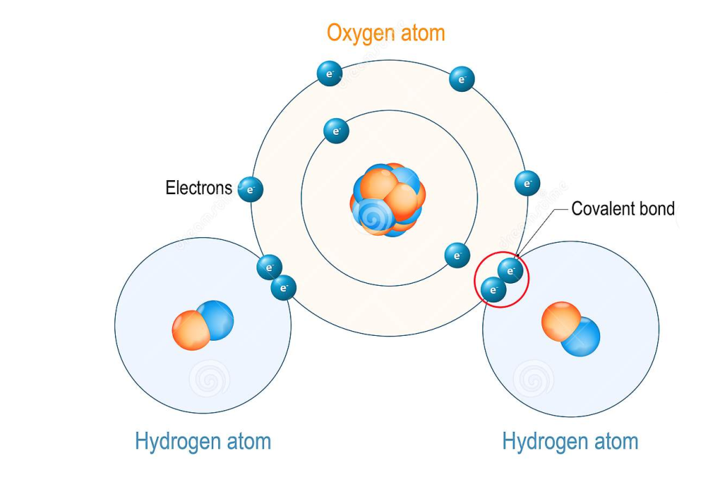
Covalent bonding
Covalent bonding | Example
The atoms involved in the reaction share electrons. Covalent bonds are strong, and the molecules formed are usually neutral. In some covalent bonds, electrons are not shared evenly. So this results in a molecule with a slightly negative and slightly positive side. This separation of charge is called dipole. The molecule is described as a polar molecule.

Slide 9
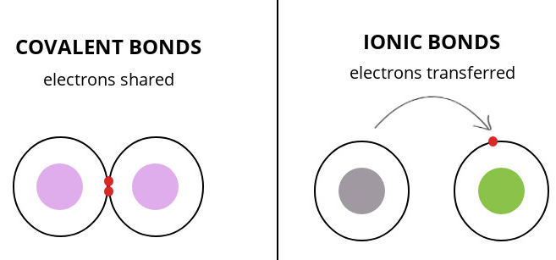

Slide 10
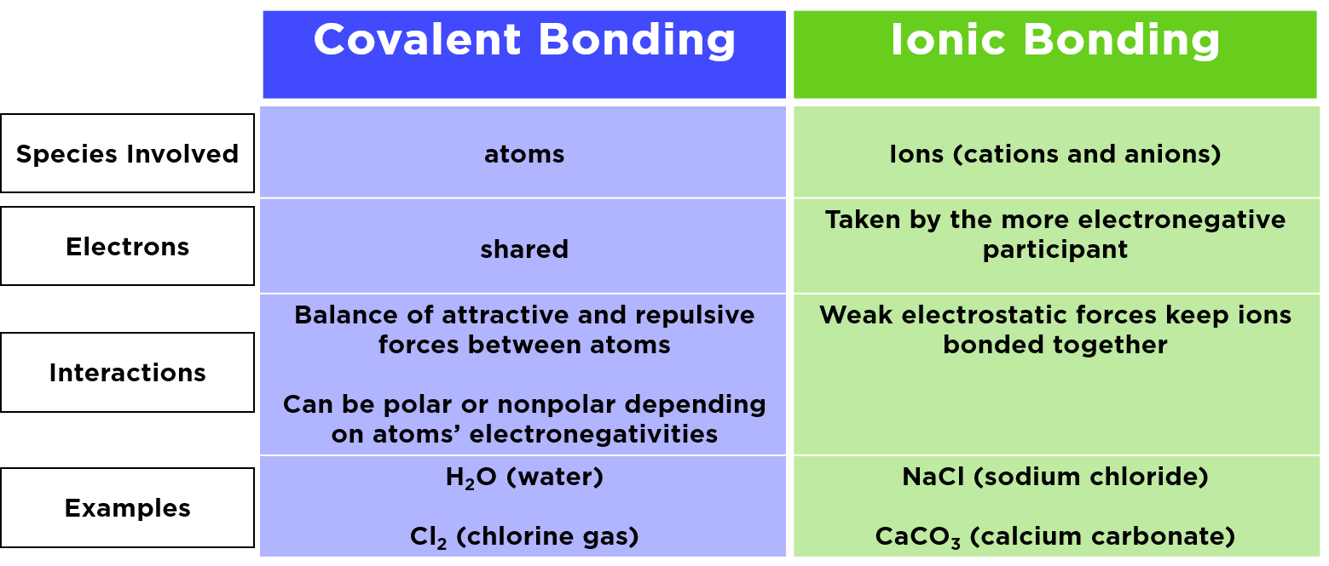
Electronegativity is defined as the tendency of an atom participating in a covalent bond to attract the bonding electrons.

Slide 11
INORGANIC IONS
Occur in solution in the cytoplasm and body fluids of organisms
Some in high concentrations and others in very low concentrations
Each type of ion has a specific role, depending on its properties and these roles are relevant in a range of topics across the A Level
lIonic substances dissolve in water, the ions separate in a process called dissociation.

Slide 13
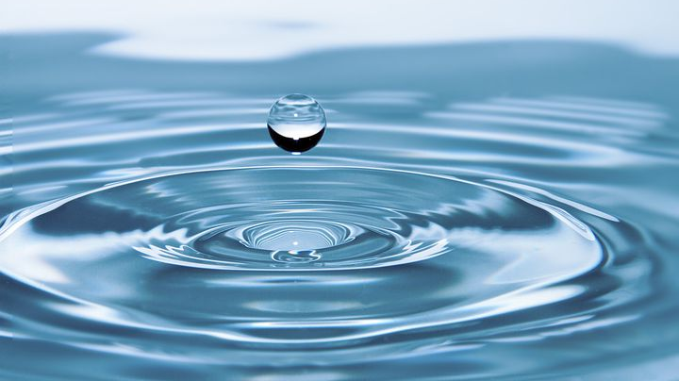
WATER
Water exists in different physical states – solid, liquid and gas.
Makes up 70% of the surface of Earth.
65 – 90% of the weight of all living organisms.
Plays important role in all vital processes of living organisms.
Chemical formula is H2O.

Slide 14
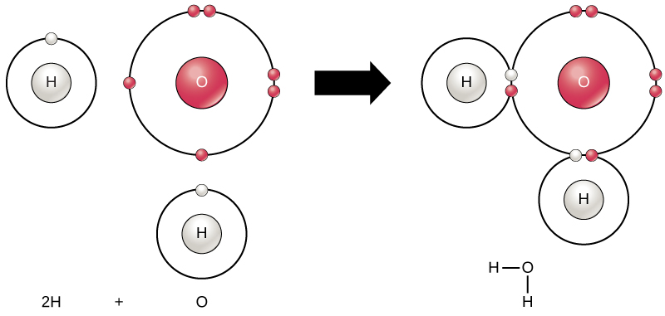
Water molecule

Slide 15
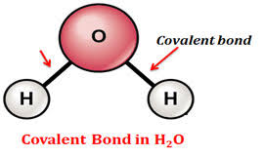
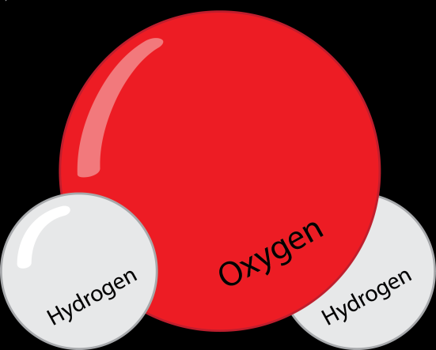
Structure
A water molecule consists of two Hydrogen atoms covalently bonded to an Oxygen atom.

Slide 16
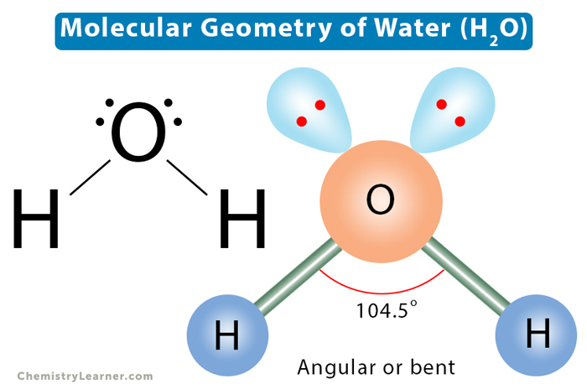
Because lone pairs push bonding pairs closer together, the H–O–H angle decreases to about 104.5°.

Slide 17
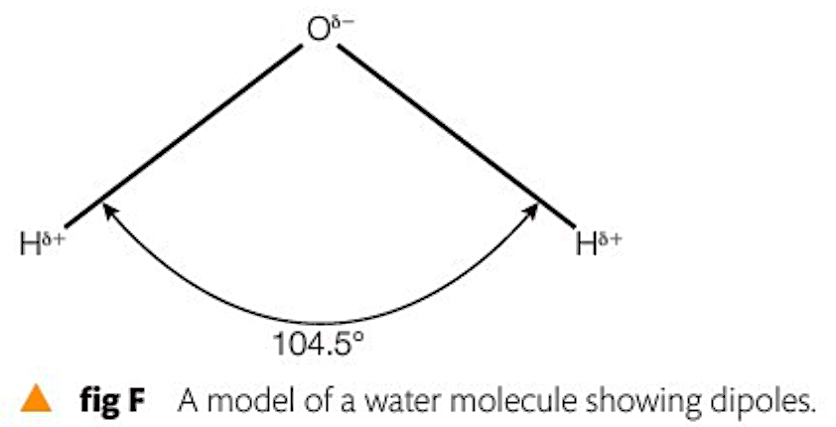
Water molecule

Slide 18
Dipole nature of the water molecule
Covalent bonding | Example
In water molecules, oxygen and hydrogen form covalent bonds. These atoms share electrons. Covalent bonds are strong and the molecules formed are usually neutral. Some covalent bonds are not shared evenly. So this results in a molecule with a slightly negative and slightly positive part. This separation of charge is called dipole. The molecule is describe as a polar molecule.

Slide 19
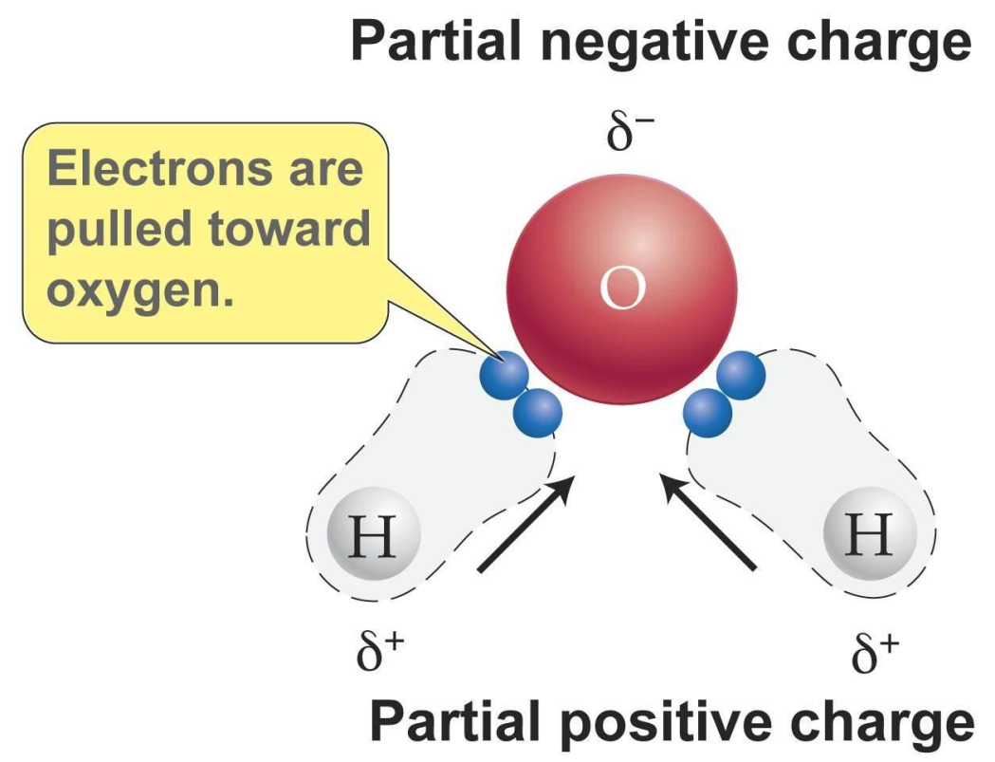
Dipole nature of the water molecule
The hydrogen end of the molecule is slightly positive.
The oxygen end is slightly negative because the electrons are more concentrated at that end.
Water is therefore called a Polar molecule.
It is this polarity that accounts for many of its biologically important properties.

Slide 20
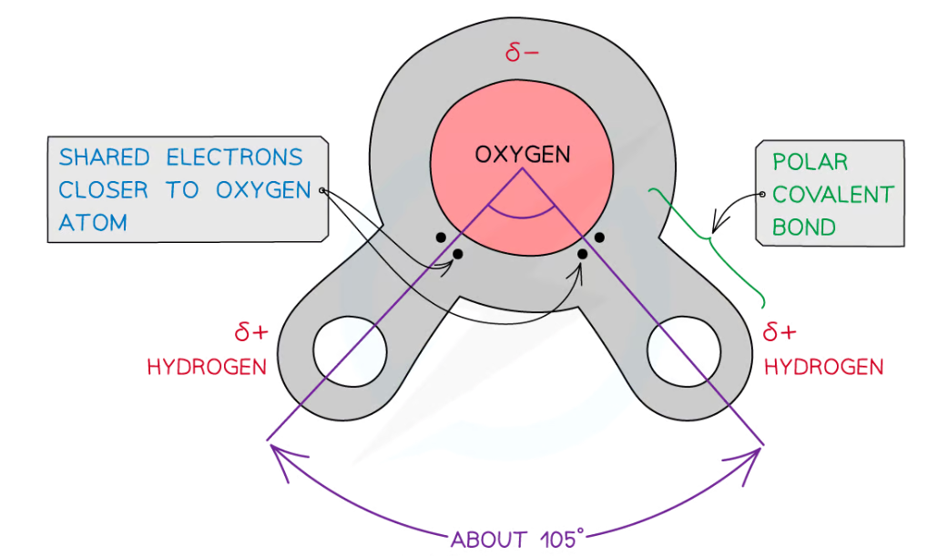
Dipole nature of the water molecule

Slide 21
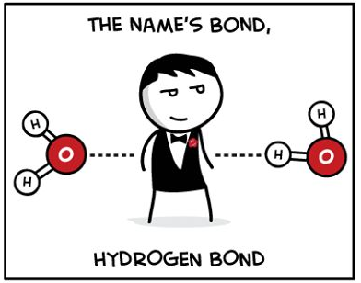
Dipole nature of the water molecule
One major effect of polarity is water molecules form hydrogen bonds.

Slide 22
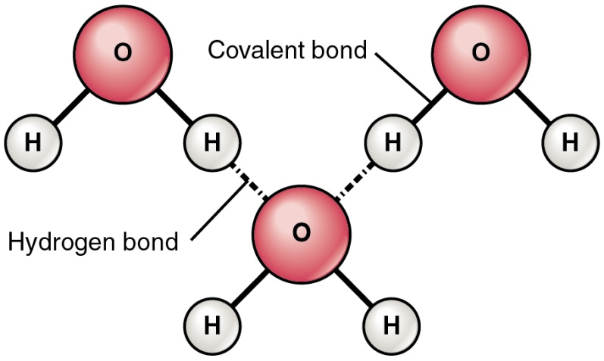
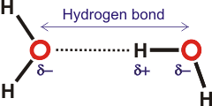
Dipole nature of the water molecule
The charge differences cause water molecules to be attracted to each other and to other polar molecules and ionic substances.
Each individual hydrogen bond is weak but there are many of them so the molecules of water stick together.

Slide 23
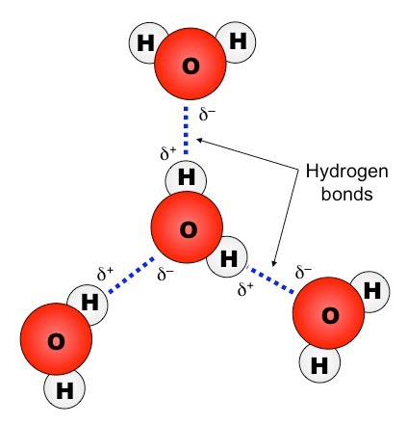
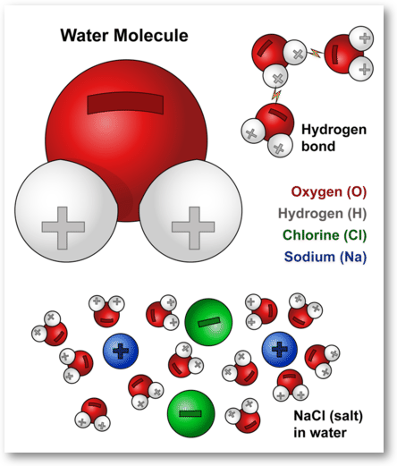
Dipole nature of the water molecule
(a) Water to water attraction (b) Water to other molecules attraction

Slide 24
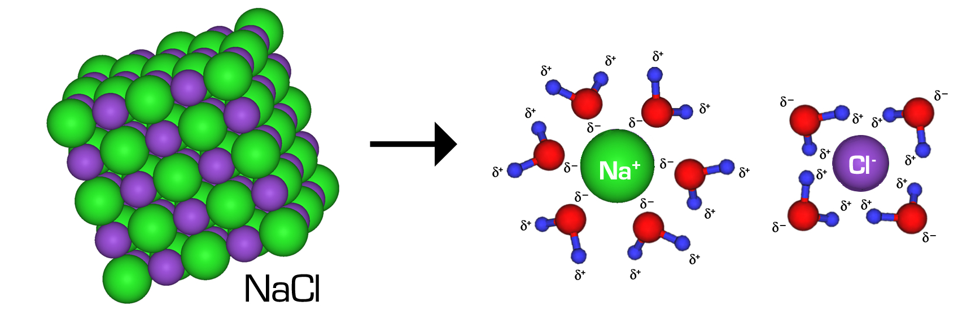
Properties of water:
POLAR SOLVENT
Water is a polar solvent.
Many ionic substances will
dissolve in it.
Many covalently bonded
substances are also polar and will dissolve in water.
Such polar substances are said to be hydrophilic – ‘water-loving’.
Notes:
Water is regarded as the ‘general solvent’ or ‘universal solvent’ due to the polarity of its molecules.
For example, when sodium chloride (NaCl) dissolves in water, it produces positive sodium ions and negative chlorine ions. The positive hydrogen atoms in water attract the negative chlorine ions, and the negative oxygen atoms attract the positive sodium ions. All polar substances (substances containing ions) can dissolve in polar solvents, such as water.
All the essential substances for living organisms (vitamins, salts, amino acids, gases, and glucose) transport inside their bodies in the form of solutes dissolved in water. These substances take part in metabolic reactions inside the cells.
Water also carries substances such as starch as a result, most of the chemical reaction within cells occur in water (in aqueous solution). Water is an excellent transport medium because the dipole nature of water enables many different substances to dissolve in it.
Water is good solvent for other polar molecules since it can interact with the charged regions and dissolve the substance. It is also a good solvent for ionic substances, since the water molecules cluster around the ions and separate them, thus dissolving the substance. This property, along with the fact that water is liquid over a wide range of temperatures, makes it ideal for acting as a medium in which metabolic reactions can occur, and also as a transport vehicle.
Water also takes part in some metabolic reactions, for example, in Hydrolysis and Condensation reactions.
Polar molecules also dissolve easily in water.
Their polar groups, for example the –OH group in sugars or the amine group, –NH2, in amino acids, become surrounded by water and go into solution.
Such polar substances are said to be hydrophilic – ‘water-loving’.
Non-polar, hydrophobic substances, such as lipids, do not dissolve in water. To enable transport in blood, lipids combine with proteins to form lipoproteins.

Slide 25
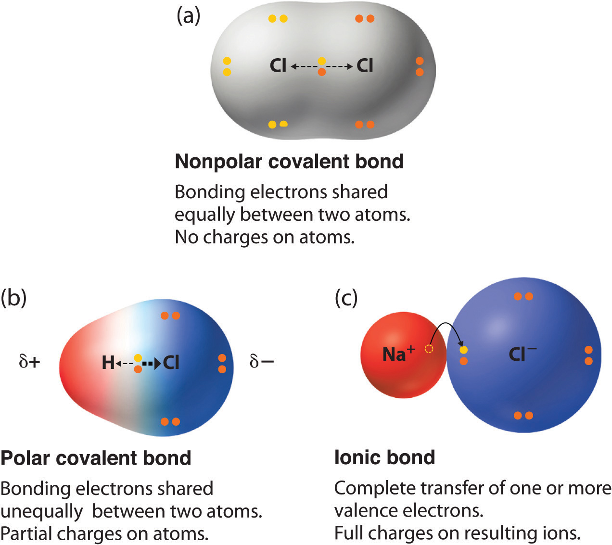
It is important to note that polar molecules are not the same as ionic molecules!!
Ionic compounds are held together by ionic bonds that arise due to electrostatic forces between ions. In such cases, one of the atoms loses an electron to form a cation and another atom gains an atom to form an anion. Eg: Na+/Cl-
In polar compounds the electron pair is shared by two chemical species. However, the electron pair is shared in an unequal manner owing to the differences in the electronegativities of the two chemically bonded species. This results in one side of molecule to have a partially positive charge while the other side have a partially negative charge. Eg: glucose/amino acids/molecules with OH/NH2 groups.

Slide 26
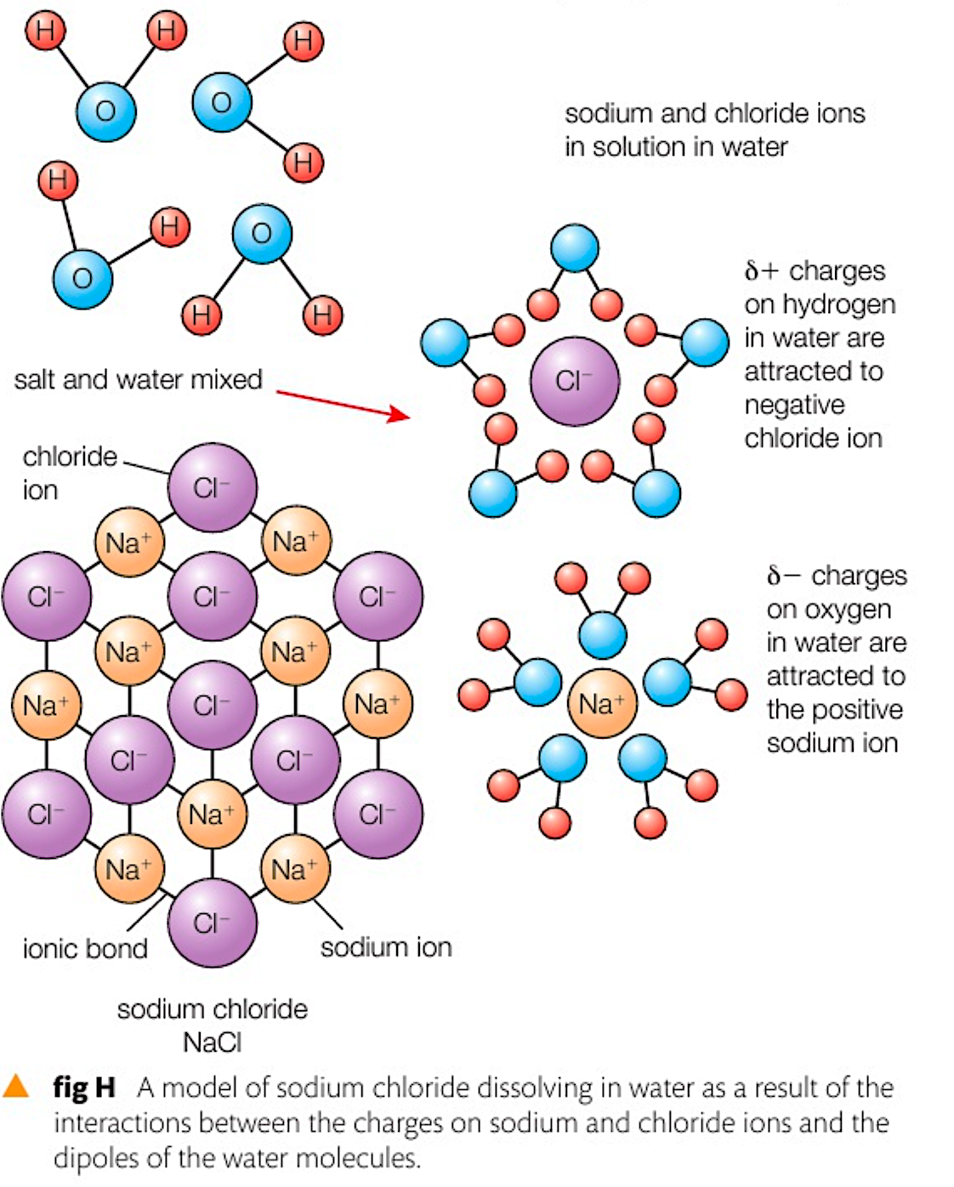
Water is a polar solvent and ions are charged.
Water separates the ions from the lattice.
Water surrounds/ clusters around the ions.
Sodium ions will bind to / be attracted to the oxygen of water.
And chloride ions will bind to / be attracted to the hydrogens of water.
This way, Na+ and Cl− ions dissolves in water.
Notes:
Water is regarded as the ‘general solvent’ or ‘universal solvent’ due to the polarity of its molecules.
All the essential substances for living organisms (vitamins, salts, amino acids, gases, and glucose) transport inside their bodies in the form of solutes dissolved in water. These substances take part in metabolic reactions inside the cells.
Water also carries substances such as starch as a result, most of the chemical reaction within cells occur in water (in aqueous solution). Water is an excellent transport medium because the dipole nature of water enables many different substances to dissolve in it.
Water is good solvent for other polar molecules since it can interact with the charged regions and dissolve the substance. It is also a good solvent for ionic substances, since the water molecules cluster around the ions and separate them, thus dissolving the substance. This property, along with the fact that water is liquid over a wide range of temperatures, makes it ideal for acting as a medium in which metabolic reactions can occur, and also as a transport vehicle.
Water also takes part in some metabolic reactions, for example, in Hydrolysis and Condensation reactions.

Slide 27
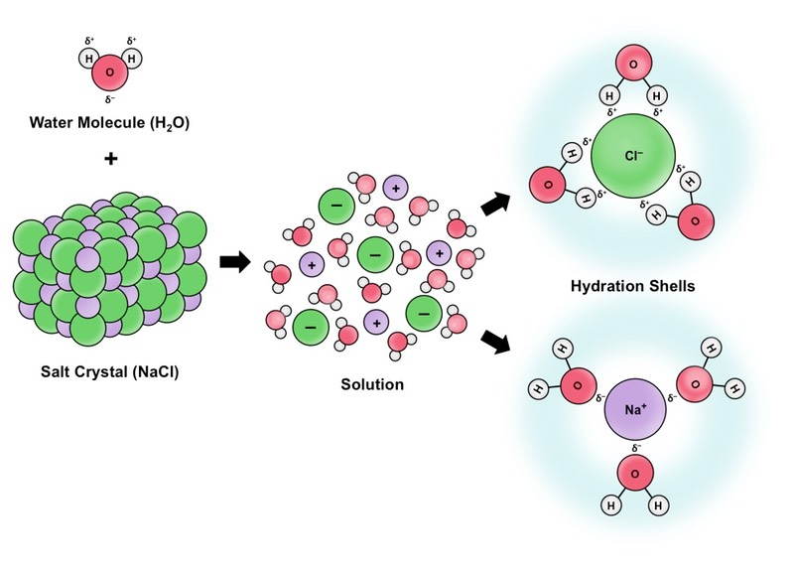

Slide 28
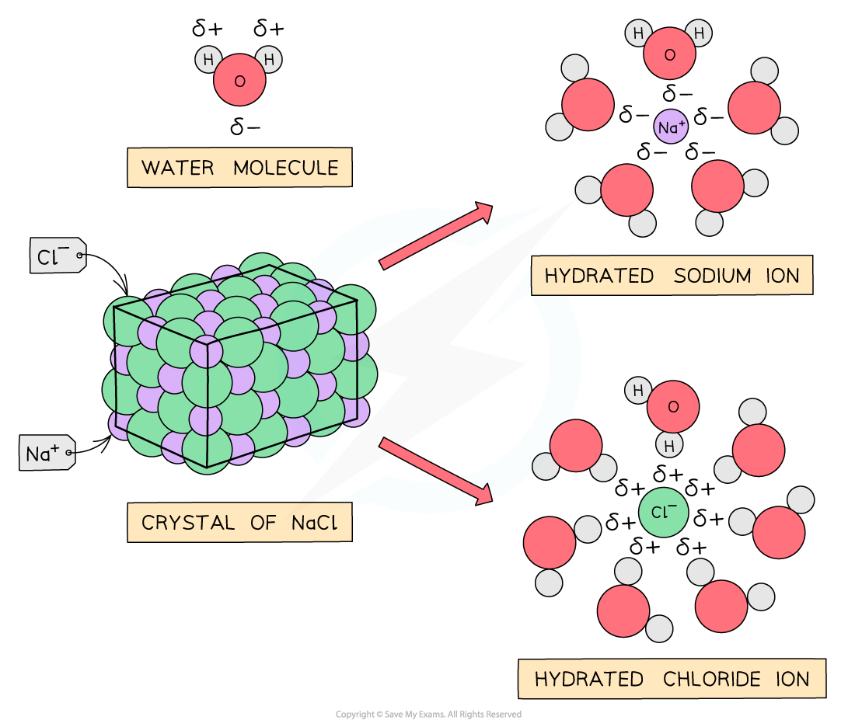

Slide 29
The surrounded molecules break apart e.g. sodium chloride molecules break into sodium ions and chloride ions
The ions surrounded by water molecules have dissolved.
This allows chemical reactions to occur within cells as the dissolved solutes are more chemically reactive when they are free to move about.
Metabolites can be transported efficiently in a dissolved state.
Notes:
Water is regarded as the ‘general solvent’ or ‘universal solvent’ due to the polarity of its molecules.
All the essential substances for living organisms (vitamins, salts, amino acids, gases, and glucose) transport inside their bodies in the form of solutes dissolved in water. These substances take part in metabolic reactions inside the cells.
Water also carries substances such as starch as a result, most of the chemical reaction within cells occur in water (in aqueous solution). Water is an excellent transport medium because the dipole nature of water enables many different substances to dissolve in it.
Water is good solvent for other polar molecules since it can interact with the charged regions and dissolve the substance. It is also a good solvent for ionic substances, since the water molecules cluster around the ions and separate them, thus dissolving the substance. This property, along with the fact that water is liquid over a wide range of temperatures, makes it ideal for acting as a medium in which metabolic reactions can occur, and also as a transport vehicle.
Water also takes part in some metabolic reactions, for example, in Hydrolysis and Condensation reactions.

Slide 30
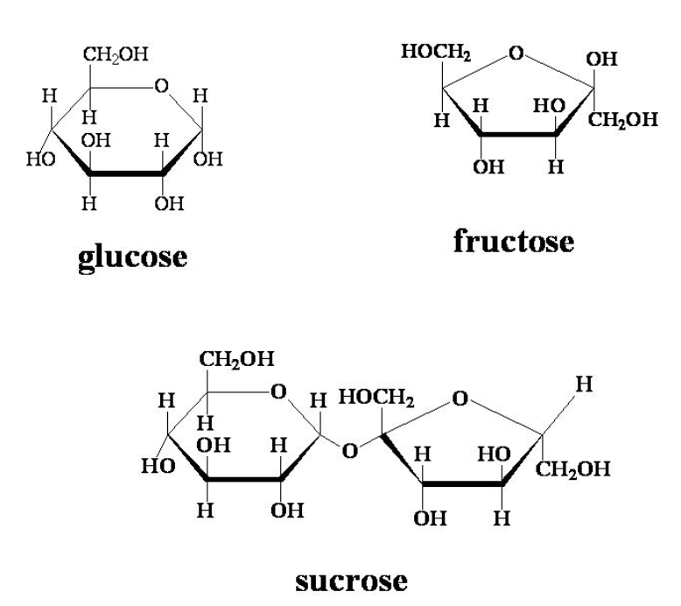
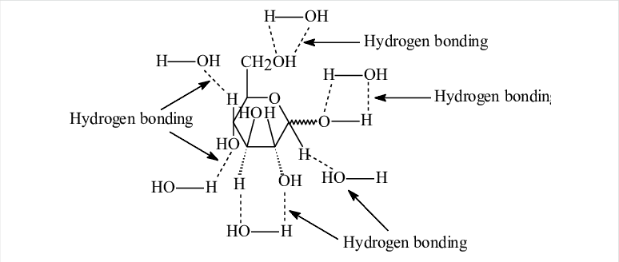
Hydroxyl (OH) groups in glucose forms hydrogen bonds with water and dissolves in water.

Slide 31
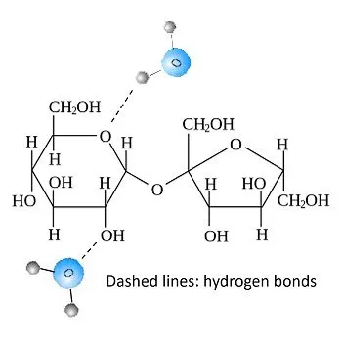
Hydroxyl (OH) groups in sucrose forms hydrogen bonds with water and dissolves in water.

Slide 32
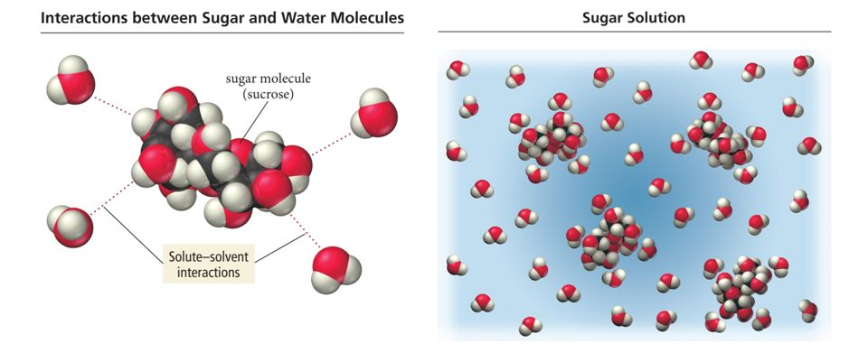
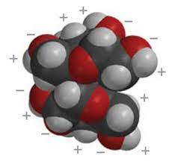
Sugars such as glucose/sucrose are larger than NaCl, hence can be surrounded by more water molecules.
Sugars have more hydroxyl groups/ polar groups, therefore they are able to form more H-bonds with water molecules.
Therefore they are more soluble in water than ionic compounds like NaCl.
Polar sugar molecule

Slide 33
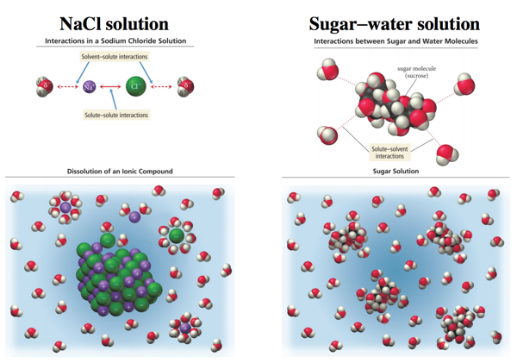

Slide 34
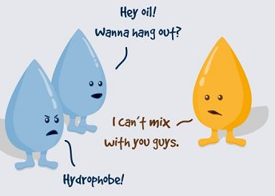
Properties of water:
POLAR SOLVENT
Non-polar, hydrophobic -”water hating” substances, such as lipids, do not dissolve in water.
Fatty acids have hydrophobic tails, they do not form H-bonds with water.
Water also carries substances such as starch.
Notes:
Water is regarded as the ‘general solvent’ or ‘universal solvent’ due to the polarity of its molecules.
All the essential substances for living organisms (vitamins, salts, amino acids, gases, and glucose) transport inside their bodies in the form of solutes dissolved in water. These substances take part in metabolic reactions inside the cells.
Water also carries substances such as starch as a result, most of the chemical reaction within cells occur in water (in aqueous solution). Water is an excellent transport medium because the dipole nature of water enables many different substances to dissolve in it.
Water is good solvent for other polar molecules since it can interact with the charged regions and dissolve the substance. It is also a good solvent for ionic substances, since the water molecules cluster around the ions and separate them, thus dissolving the substance. This property, along with the fact that water is liquid over a wide range of temperatures, makes it ideal for acting as a medium in which metabolic reactions can occur, and also as a transport vehicle.
Water also takes part in some metabolic reactions, for example, in Hydrolysis and Condensation reactions.
Polar molecules also dissolve easily in water.
Their polar groups, for example the –OH group in sugars or the amine group, –NH2, in amino acids, become surrounded by water and go into solution.
Such polar substances are said to be hydrophilic – ‘water-loving’.
Non-polar, hydrophobic substances, such as lipids, do not dissolve in water. To enable transport in blood, lipids combine with proteins to form lipoproteins.

Slide 35
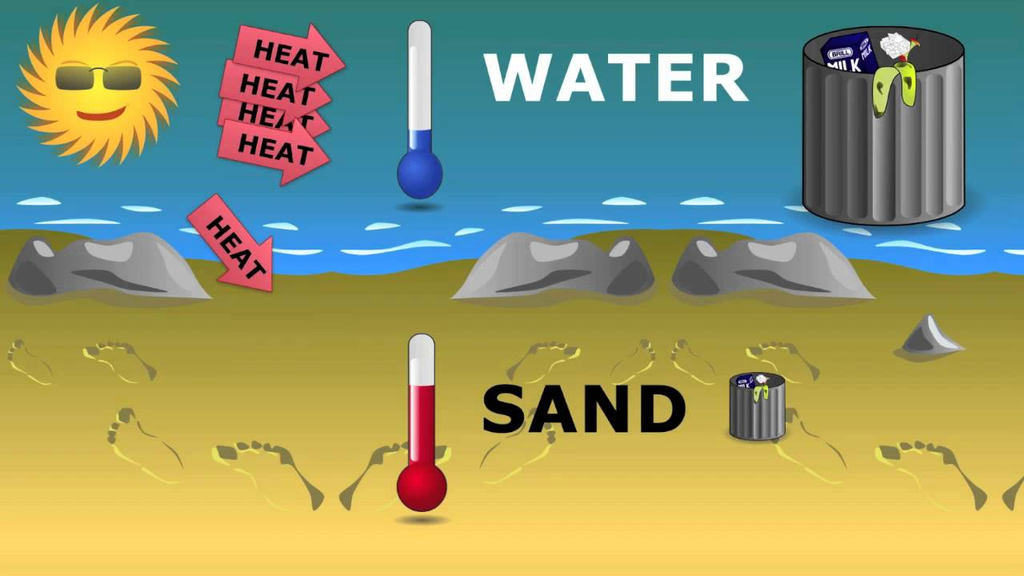
Properties of water:
HIGH SPECIFIC HEAT CAPACITY
Water is slow to absorb and release heat, hence it has a high specific heat capacity.
The presence of many hydrogen bonds between the water molecules means that a lot of heat energy is needed to separate the water molecules from each other.
So, the temperature of large bodies of water/ lakes/ rivers/ oceans remains fairly stable. This makes them good habitats for organisms.
Notes:
Hydrogen bonds within water give it a high stability, which means that a large amount of energy is required to raise the temperature of water. This property means that oceans and lakes provide a stable environment in which organisms can live. This also means that a large amount of heat is required to evaporate water, so it is very useful in cooling, for example, some animals sweat to cool down.

Slide 36
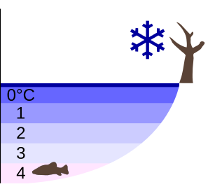
Properties of water:
DENSITY DECREASES UNDER 4ºC
As water cools to 4°C, it reaches its maximum density.
Ice is less dense than water and floats, forming an insulating layer.
This property enables organisms to live in water even in very cold winters which can otherwise result in freezing of water bodies/habitats.
Notes:
As water decreases in temperature, its molecules are less able to break the Hydrogen bonds, as they have less kinetic energy. This means that a semi-crystalline structure is formed, which holds the water molecules apart, making ice less dense than liquid water, such that it floats. This means that it insulates the water beneath, allowing organisms in the liquid water to survive.

Slide 37
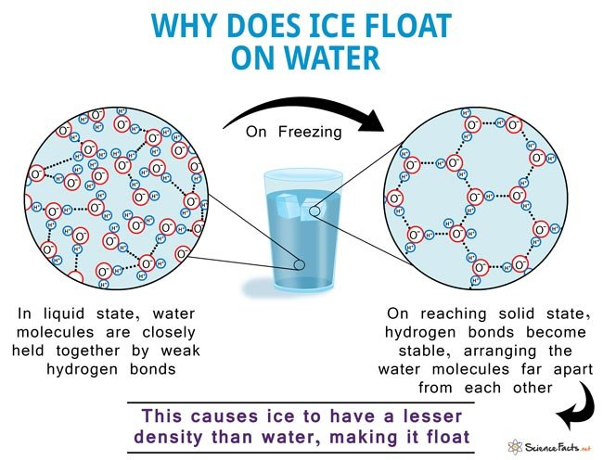
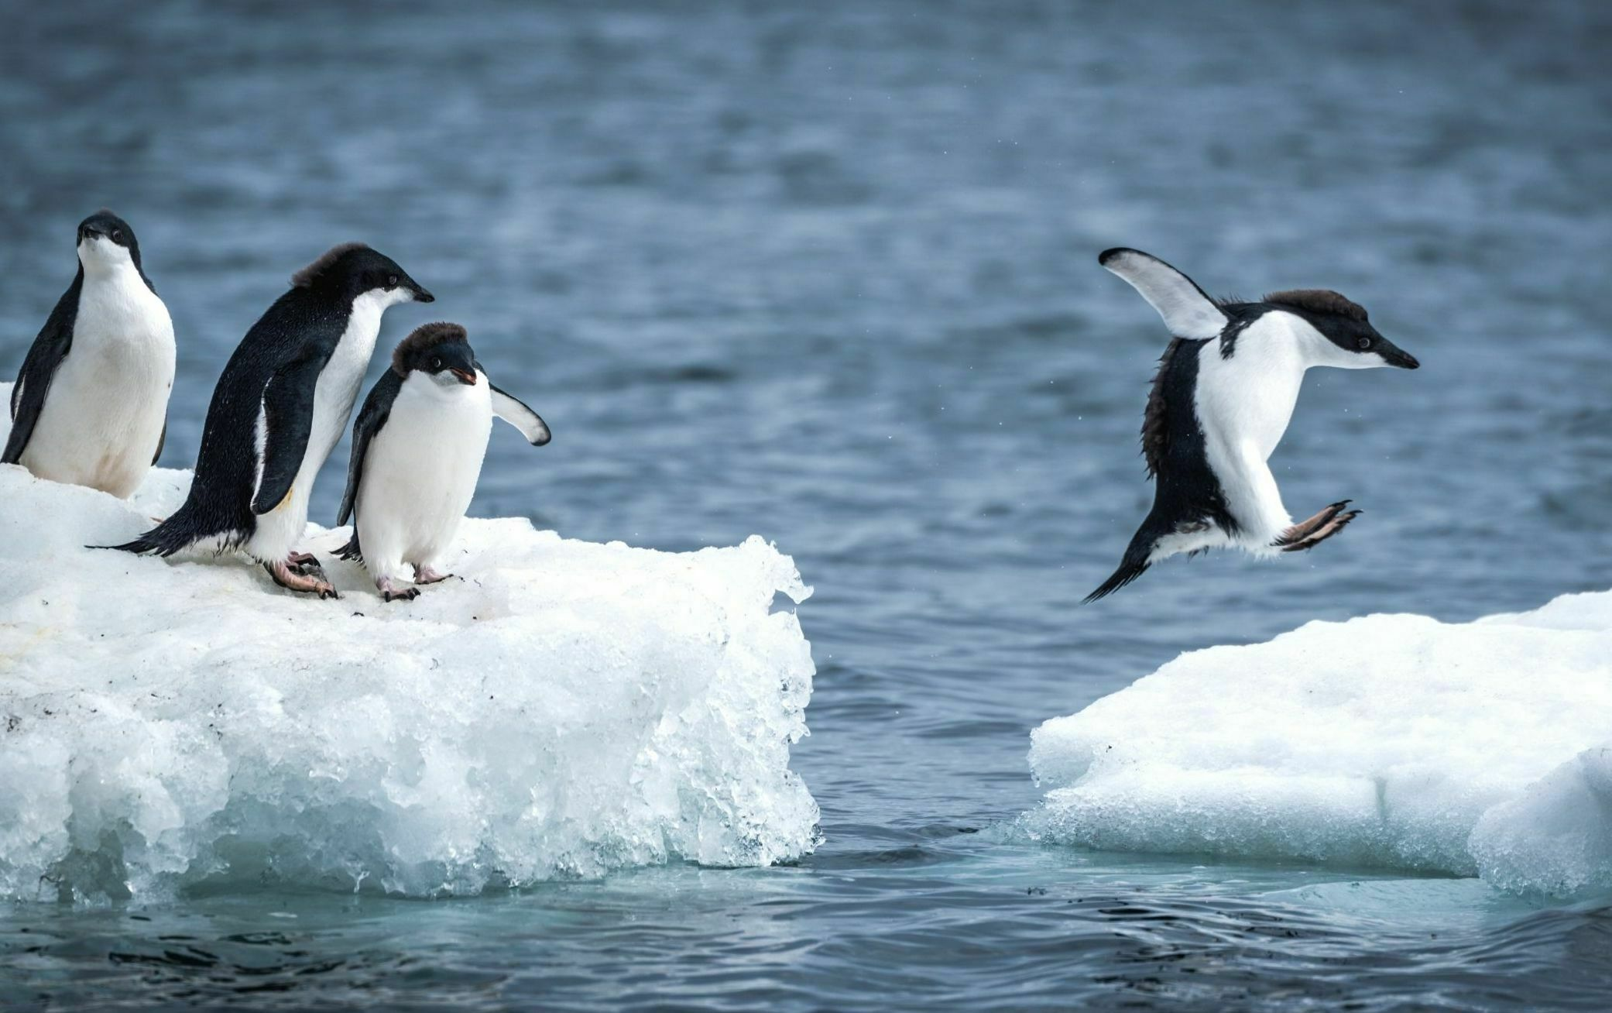
Properties of water:
DENSITY DECREASES UNDER 4ºC
Ice provides habitat for organisms such as penguins in Antarctica.
And water underneath is insulated by the ice protecting and providing a habitat for aquatic organisms.
Notes:
As water decreases in temperature, its molecules are less able to break the Hydrogen bonds, as they have less kinetic energy. This means that a semi-crystalline structure is formed, which holds the water molecules apart, making ice less dense than liquid water, such that it floats. This means that it insulates the water beneath, allowing organisms in the liquid water to survive.

Slide 38
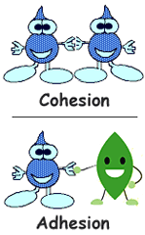
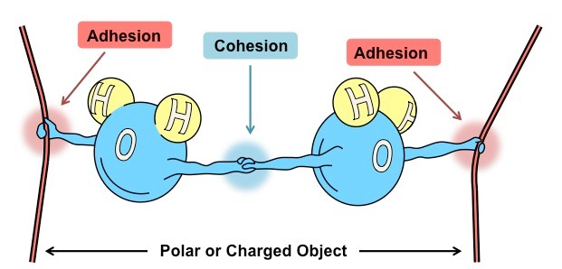
Properties of water:
COHESION AND ADHESION
Water molecules are cohesive-the force between the water molecules mean they stick together.
Water molecules are adhesive- they are attracted to other different molecules.
Notes:
Cohesion is the tendency of molecules within a substance to ‘stick together’. Water has a high Cohesion because of Hydrogen bonding. This is important as transport of water in the Xylem in plants relies on water being pulled up. Cohesion also gives the water a high surface tension, allowing small organisms, such as Pond Skaters, to walk along it.

Slide 39
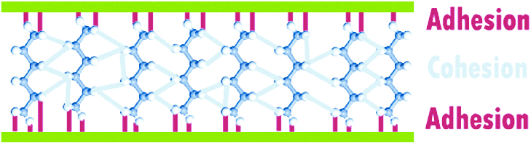
Cohesion is the tendency of molecules within a substance to ‘stick together’.
Water has a high Cohesion because of Hydrogen bonding.
This is important as transport of water in the xylem in plants relies on water being pulled up.
Cohesion also gives the water a high surface tension, allowing small organisms, such as Pond Skaters, to walk along it.

Slide 40
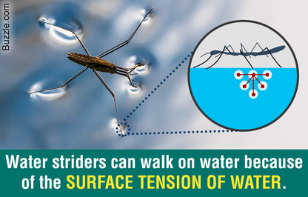
Properties of water:
HIGH SURFACE TENSION
Water has high surface tension because of the attraction between the water molecules.
The attraction of hydrogen bonds between water molecules is greater than the attraction between the water molecules and other molecules in air.

Slide 41
High surface tension
High surface tension means that the water surface acts as a “skin”; this is very important
in water being drawn up the phloem of a plant and for life at the surface of ponds/lakes.

Slide 42
SUMMARY: Solvent Properties of Water
Water is a good transport medium as it is a polar solvent.
Water; because of its dipolar nature, surrounds ionic/polar molecules and form H- bonds, dissolving them.
It is a liquid hence is able to flow due to the cohesive and adhesive forces.
Water allows transport of polar substances like glucose and amino acids in mass transport in blood of animals.
Water allows transport of inorganic ions from roots to leaves in plants via xylem vessels.
Water acts as an aqueous medium to allow chemical reactions to takes place in cell cytoplasm.
Water act as a reactant in important metabolic reactions in living organisms. Eg: Hydrolysis & Photosynthesis

Slide 43
Command Words

Slide 44
Command Words

Slide 45
Command Words

Slide 46
Checkpoint Questions
1. Water is described as a dipolar molecule because it has a ____________ (1)
A positively charged hydrogen end and a negatively charged oxygen end
B positively charged hydrogen end and a positively charged oxygen end
C negatively charged hydrogen end and a negatively charged oxygen end
D negatively charged hydrogen end and a positively charged oxygen end
ANSWER: A

Slide 47
Checkpoint Questions
2. Fill in the blanks
Water has the chemical formula________.Water molecules are described as ________ because they have a slight positive charge at one end of the molecule and a slight negative charge at the other end. As a result, individual molecules form ___________ bonds with each other. Water is an important ____________in living organisms because most biochemical reactions takes place in aqueous solution. Water also has a high _____________which means that its temperature remains relatively stable despite large changes in the temperature of the surrounding environment.

Slide 48
Checkpoint Questions
2.
ANSWER:
H2O [1]
Bipolar / Dipolar / polar [1]
Weak hydrogen / H – bonds [1]
Solvent [1]
Specific heat capacity [1]

Slide 49
Checkpoint Questions
3. What is the name between the bond between two water molecules? (1)
ANSWER:
Hydrogen bond
4. State the property of water that enable these bonds to be formed. (1)
ANSWER:
Dipole nature

Slide 50
Checkpoint Questions
6. Explain why water is an effective molecule for transporting other molecules around living organisms. (3)
ANSWER:
water is a solvent
water is slightly charged / dipole /polar
other polar molecules or ions can dissolve in water
water is a fluid with cohesive / adhesive forces

